Slide 1
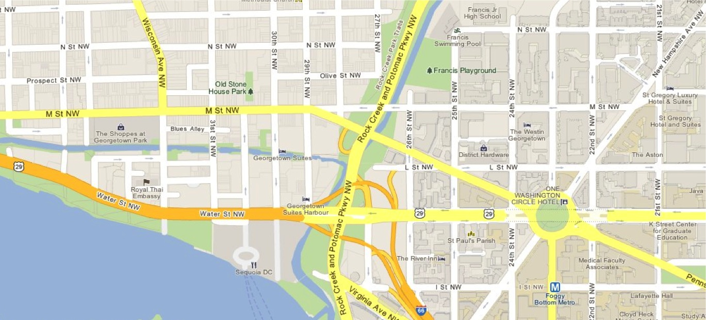
Location Types / Topic Explored
What To Look For / Pay Attention To
How are they similar to your concept?
How are they different?
How basic or varied is the menu?
Does the space feature an open kitchen?
How easy or confusing is the retail queue?
How busy are they? If they are busy, is it comfortable in line/waiting for your food?
Is it clear whether someone brings you your food, or if you wait for it at the counter?
How do you customize your order? Topping bar, condiment bar, etc.
1
Location Name
Address
4
Location Name
Address
2
Location Name
Address
5
Location Name
Address
Sample • Customize For Yourself
3
Location Name
Address
Starting or Ending Point
Take Screen Shot from Google Maps For This Part
4
1
2
3
5
Template Courtesy of LSMGuide.com

